Slide 1
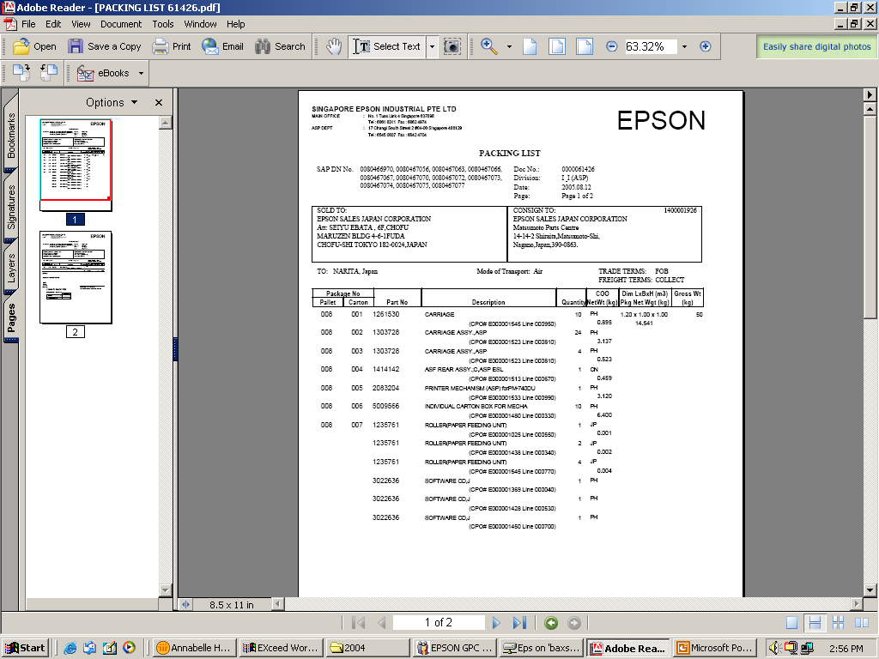
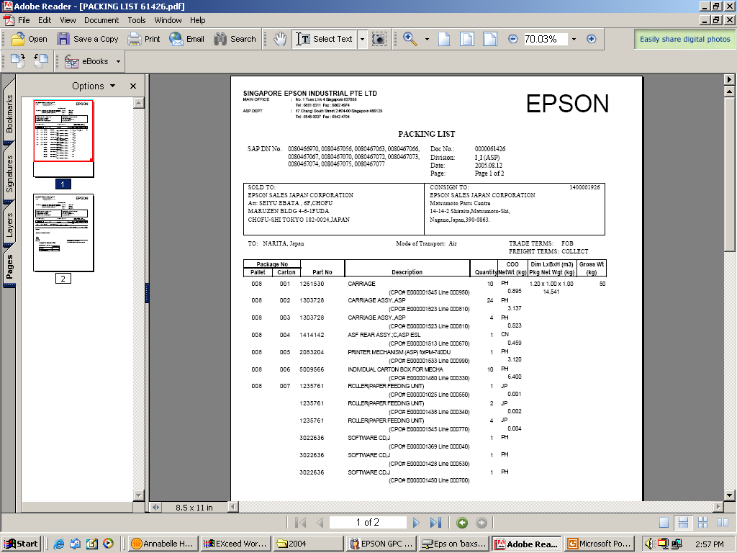
Currently, maximum no. of dns shown is 12 only, pls increase to 24 – you may reduce the font size or push down the content to next page

Slide 2
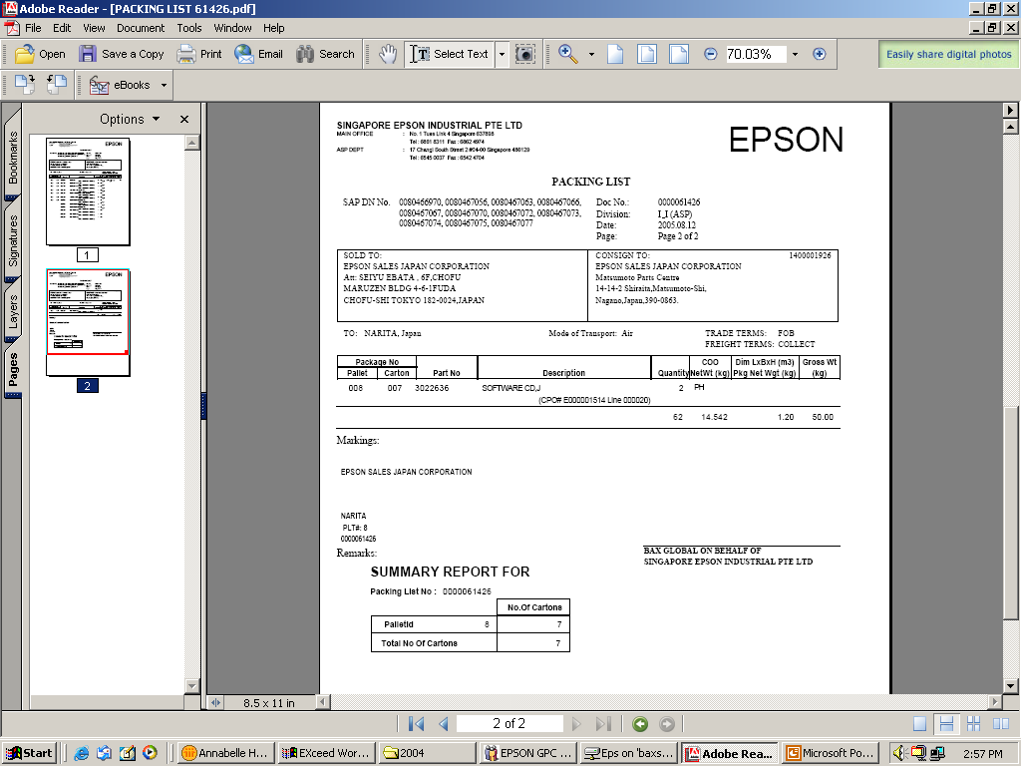
Currently maximum no. of Consignee PO shown is 4, pls increase to 10 – you may reduce font size for both Packing List & Case/Pallet label ID (if necessary)
Pls increase space for Package ID – you may leave a line above packing list no.

Slide 3
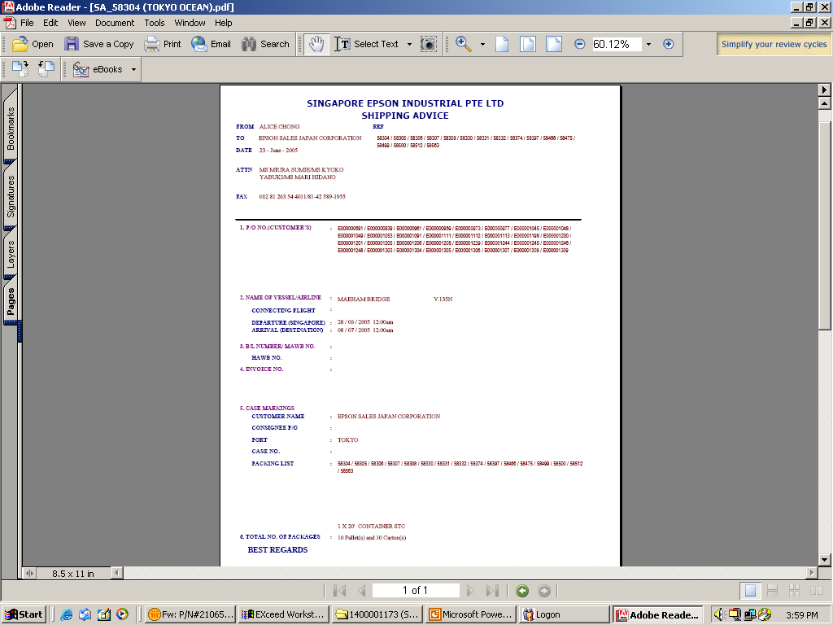
Pls increase at least 6 or more lines as no. of dns increases

